Slide 1
Developing the Data Model
Churcher ch4-5
Notes:
Prep:
Brown paper roll & pens for library exercise

Slide 2
Churcher Ch4 Learning from the Data Model Ch5 to p87Attribute, Classes & Relationships pg 68 (2nd ED)

Slide 3
Data Model not complete
“A data model is a precise description of the data stored for a real-world problem” (Churcher 2007, p53)
Not complete
Not exact description of the real situation
Always based on definitions and assumptions
Always has a limited scope
It is a model of the relationships among the data items that are being stored about a problem

Slide 4
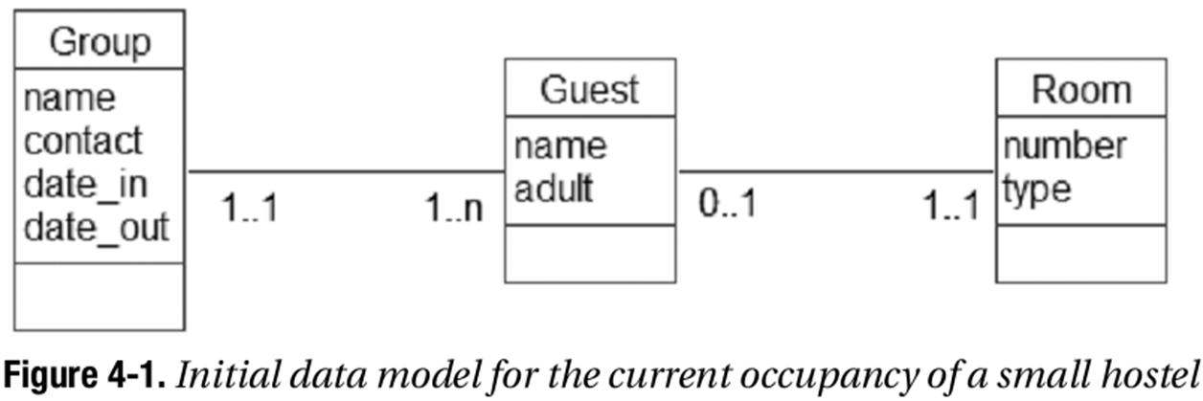
Data Model for Small Hotel
Notes:
1..1 -- 1..n for group/guest – each group can have many guests, but each guest is in a single group
0..1 – 1..1 for Guest Room – each guest is in a single room, each room may be either empty or have a single person

Slide 5
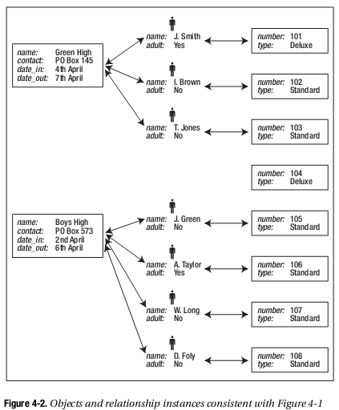
Use case for Hotel Model
Two Groups:
Green High (3 guests)
Boys High (4 guests)
NB room 104 is empty
What is the definition of a “Group” in this model?
Notes:
What is the definition of a “Group” in this model?
How would we handle A Taylor & W. Long leaving a day early?
A group (here) is not JUST a group of people travelling together or here for a particular reason – but a group that are also staying for the SAME dates

Slide 6
Group – as defined by this model
A group is a set of guests with a common contact address and with identical arrival and departure dates.
If a party of friends have different arrival or departure dates, they will need to be recorded as separate groups.
A group can have just one guest associated with it

Slide 7
Important Questions
Optionality (minimum)
Should it be 0 or 1?
Cardinality of 1 (maximum)
might it sometimes be 2?
What do we do with historical data?
Many-Many
Are we missing something?

Slide 8
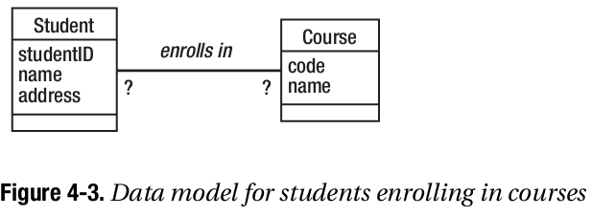
Optionality: 0 or 1?
What is a student?
Can a student be enrolled in zero courses?
What is a course?
Can a course exist with no students enrolled?
Notes:
What about a person who has contacted the Polytech asking for information about a course? Do we want to record their data?

Slide 9
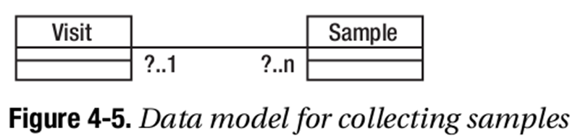
Insect collection example
Samples are collected from a farm
Can a sample ever exist without visiting the farm?
Can a visit result in no samples?
Notes:
Here’s another example of the importance of defining a class, what is a visit?

Slide 10
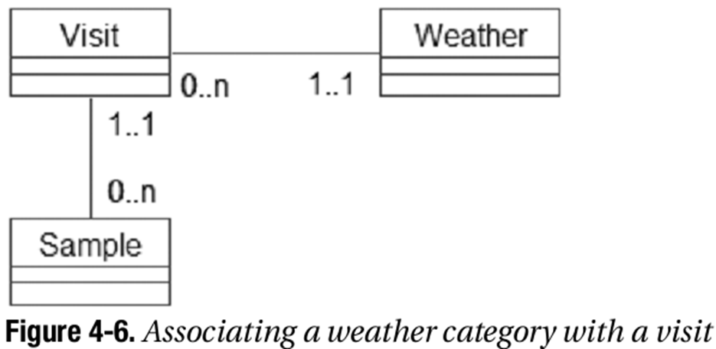
Cardinality of 1: Is it ever be 2?
Collecting weather status when visiting a farm to collect samples
Exceptions are always problematic and need to be considered
What happens if the weather changes during a visit?

Slide 11
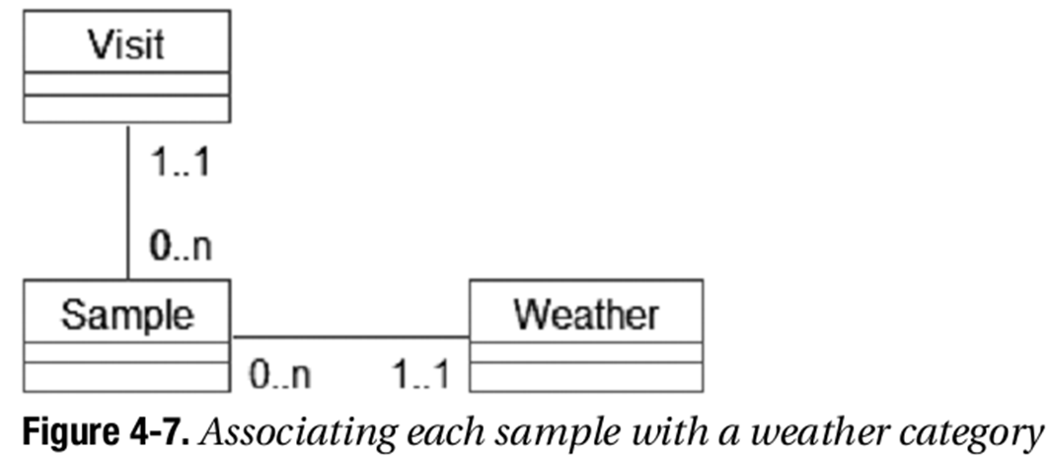
Possible improvement
May be better to associate weather to a sample rather than the visit
But this is large overhead when weather is normally stable

Slide 12

Compromise
Perhaps solve the changing weather problem by redefining a visit, rather than changing the model
A visit is a time spent on a farm during constant weather conditions on a single day collecting samples.
It is possible to have more than one visit to a farm per day.

Slide 13
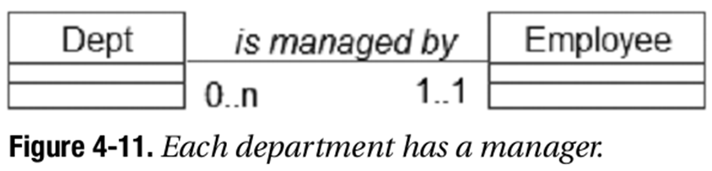
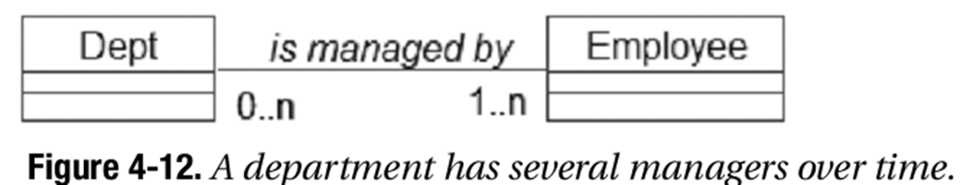
Cardinality of 1: What about history?
Do we wish to keep track of historical information?
Where there is a 1..1 this may prove tricky
Notes:
The important question here is: Do we want to keep track of former managers?
Why are we recording information about managers at all?
If it just to know who to call when something goes wrong then the current manager is probably all you need.
But what if during an audit you uncover something that went wrong last year? Then you will need to keep a history…

Slide 14
Many to Many: Are we missing anything
Whenever you see a many-many on a data model it is worth asking:
Is there any data that we need to record that depends on particular instances of each of the classes in our Many–Many relationship?
Notes:
Is there any data we need to record for the enrolment of a student in a course? Anything specific to that relationship?

Slide 15
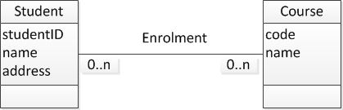
Student example
Is there any data that I want to keep that is specific to a particular student and his or her enrolment in a particular course?

Slide 16
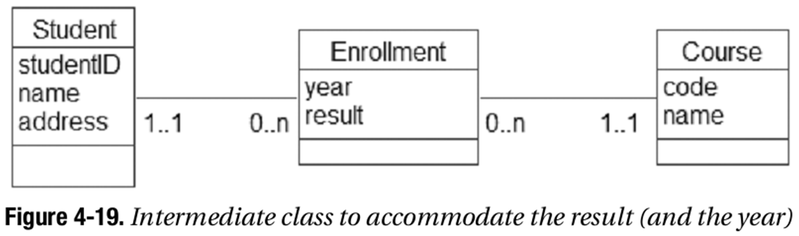
Student example
Is there any data that I want to keep that is specific to a particular student and his or her enrolment in a particular course?

Slide 17
Many-Many May be OK in Data Model
Sometimes it might be perfectly fine to have a Many:Many relationship
If there is no relationship-specific data to be stored then don’t add an intermediate class

Slide 18
Class, Attribute or Relationship?
Data may be stored as
A class
An attribute of a class
A relationship between two classes

Slide 19
No Perfect Model
It is never possible to say that a given data model is the correct one.
We can only say that it meets the requirements of a problem within a given scope, and subject to certain assumptions or approximations. (Churcher, 2007 p75)

Slide 20
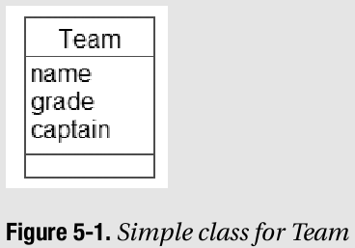
Example: Sports Club
a sports club wishes to keep very simple records of the team name, its grade, and the captain.
A single class, with several attributes

Slide 21
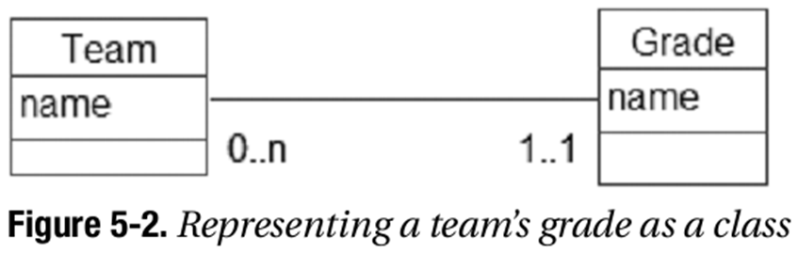
Lookup Table of “Pick List
Solves problems with typing various descriptions for the same thing – standardises input
Grade can be represented as a relationship to a standard list of grades

Slide 22
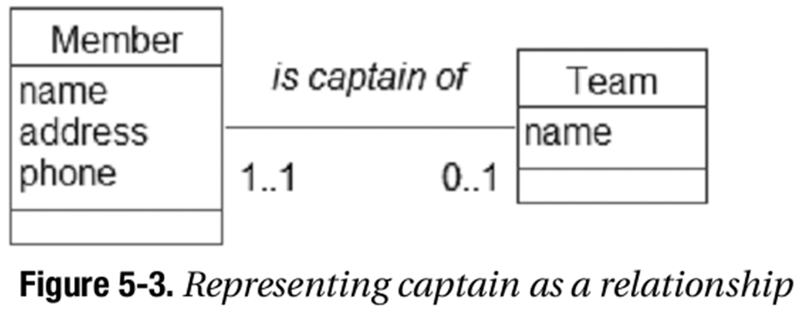
Captain – as relationship
May decide to represent who is captain by a relationship between Member and Team

Slide 23
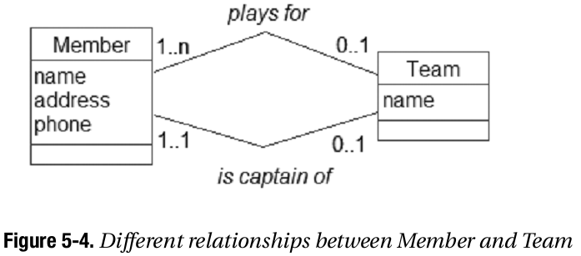
Multiple relationships between classes

Slide 24
Problems with Multiple Routes Between Classes
A number of problems can develop with multiple routes in a data model - primarily
Redundant data
Different Information

Slide 25
Redundant Information
A relationship in a data model contains, or indicates, data/information
With multiple paths between two classes we may have the same information being indicated multiple times

Slide 26
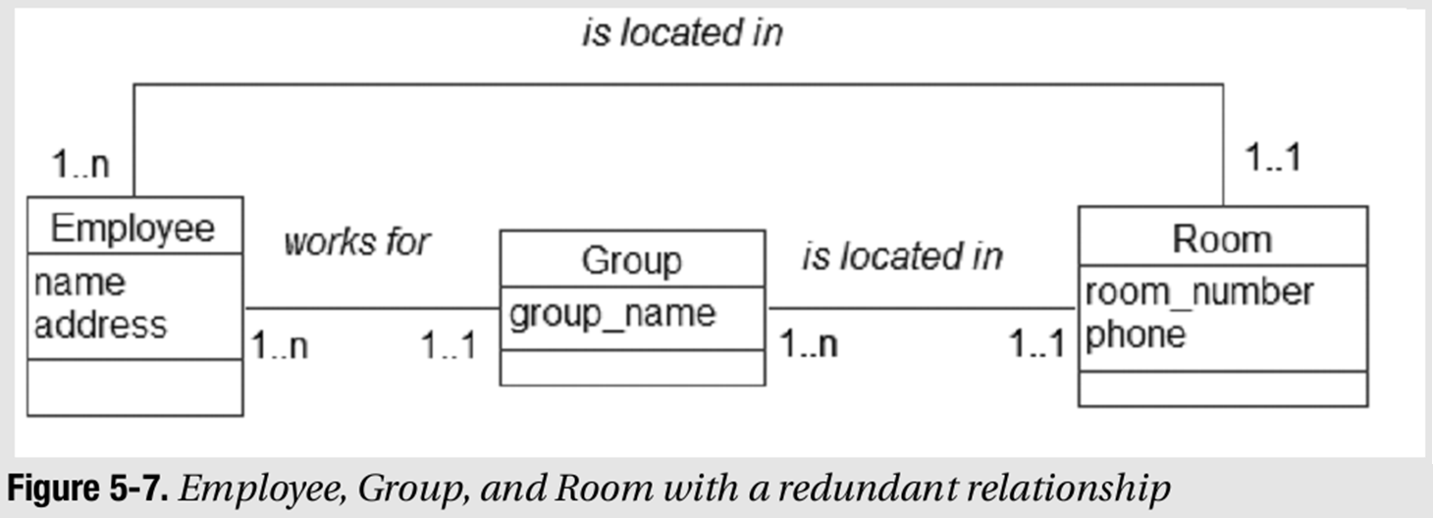
Redundant Data
What data is redundant in this model?
Need to ensure that group AND location is changed if employee moves group.
Notes:
Startup company, Employees may change groups, groups may change rooms.
This model has redundant date, can you see what it is? Careful management of the information supplied in each relationship is required to make sure the data is accurate.

Slide 27
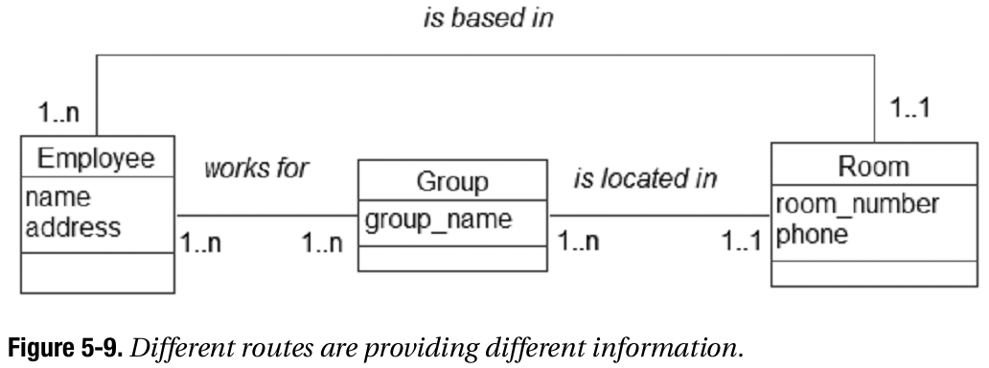
Compromise – Careful Definition of Relationship
In a real life situation it may be that an individual might be based in a different room to the main room for a group

Slide 28
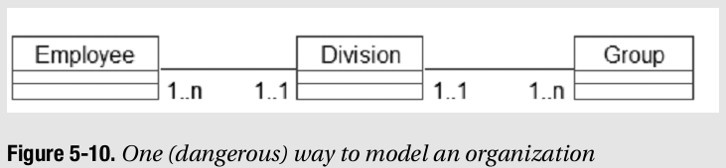
Problematic Model
What problem exists here?
You can tell which division an employee is in
You can tell which groups are in each division

Slide 29
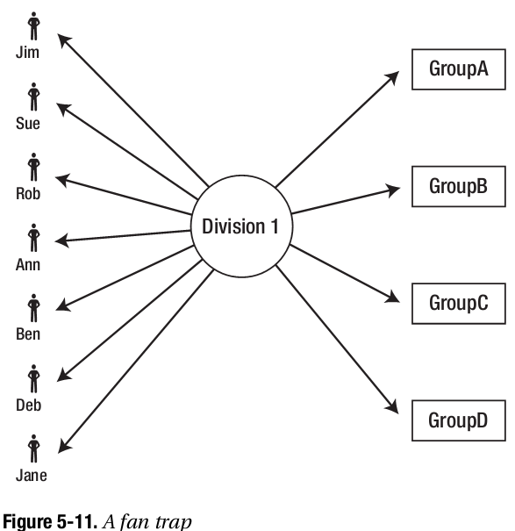
Fan Trap

Slide 30
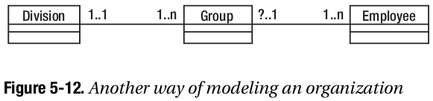
Another Problem
What’s the problem here?
We can link each employee to a group
We can link each group to a division

Slide 31
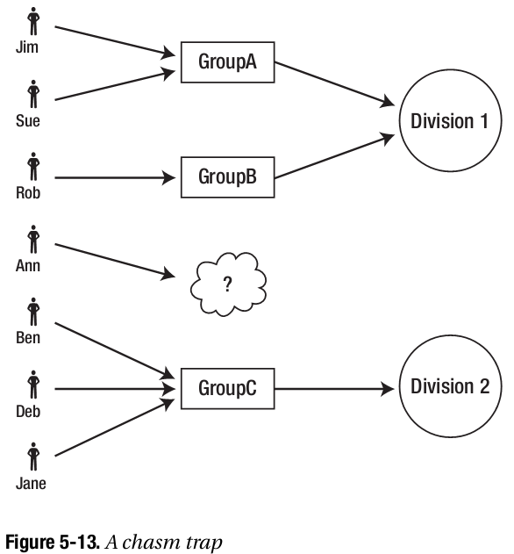
Chasm Problem
Can’t get there from here
If Ann works generally in Division 1 and not associated with a group – the model fails.

Slide 32
Exercises
Work through the Chapter 4 Testing Your Understanding. Pg 58 & digitally on the I: drive.
Read Churcher to p87 of chapt 5, to p68 in 2nd ED

